Slide 1
The Wranglers
COVID-19 & Air Quality
2021/4/28
Teigen Judd, Jon Barton, Yi-Jin Chen, Adriana Reyes-Miranda
Notes:
Jon

Slide 2
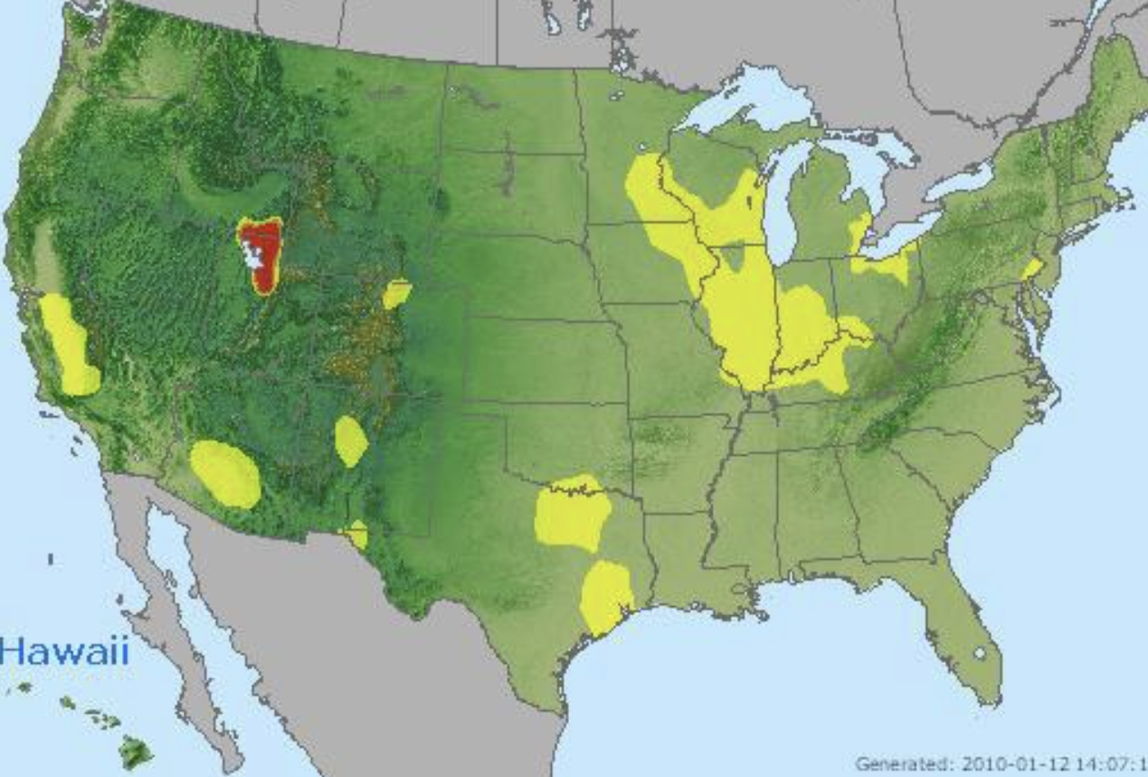
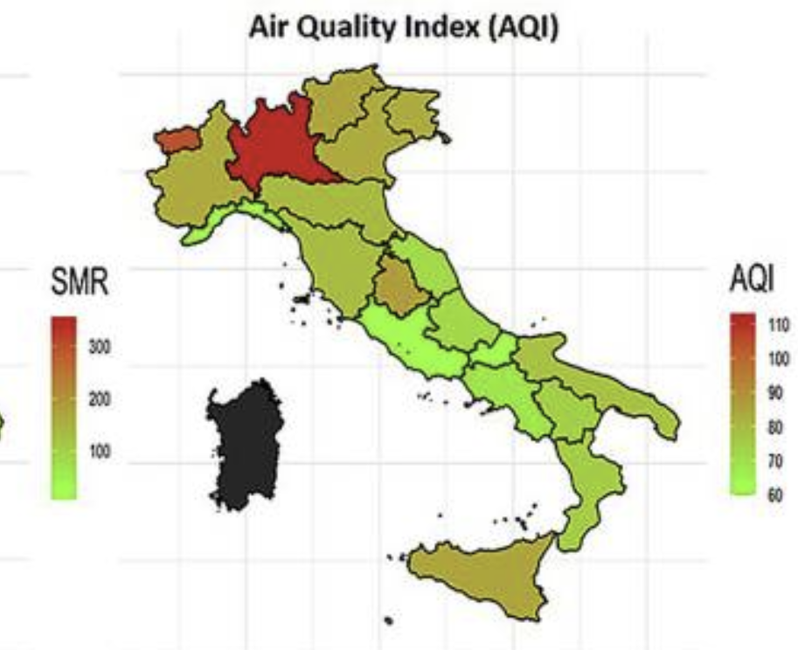
COVID-19 & Air Quality
Notes:
jon

Slide 3
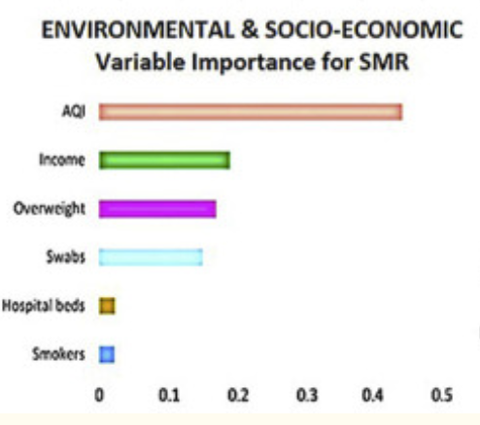
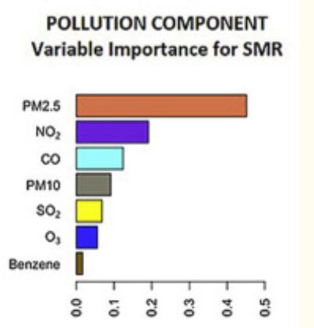
Problem
The original study used machine learning methods to reveal the prolonged exposure to air pollution associated with SARS-CoV-2 in Italy. [1]
Notes:
Jin
The original study used machine learning methods to reveal the prolonged exposure to air pollution associated with SARS-CoV-2 in Italy. They explored environmental and socio-economic factors for SARS-CoV-2 standardized mortality ratio (SMR) and analyzed the pollution sector and pollution component. In their results, the top three pollution components are PM2.5, NO2 and CO. PM2.5 is the main component and the most crucial predictor of SARS-CoV-2 effects even with a slight decrease of air quality (AQI).

Slide 4
Original Description of the Data - Air Quality
EPA https://aqs.epa.gov/aqsweb/documents/data_mart_welcome.html
In the beginning:
https://www.epa.gov/outdoor-air-quality-data/download-daily-data
Final (provided by Professor Naomi Riches):
https://aqs.epa.gov/aqsweb/airdata/download_files.html
Notes:
Jin
The air quality data comes from EPA (https://aqs.epa.gov/aqsweb/documents/data_mart_welcome.html). The EPA keeps measurements of various air pollutants at thousands of locations across the United States. This data is publicly available at EPA.gov.
In the beginning, we downloaded data from Outdoor Air Quality Data (https://www.epa.gov/outdoor-air-quality-data/download-daily-data). Each pollutant had to be downloaded separately, broken down by year and geographic area. Since that process is time consuming, we decided to use a different website to get all the required data easily (https://aqs.epa.gov/aqsweb/airdata/download_files.html thanks to Professor Naomi Riches for sharing.)

Slide 5
Original Description of the Data - COVID-19
Provided by John’s Hopkins
https://github.com/CSSEGISandData
In an aggregated format, with reporting down to county level.
Data reporting began whenever individual counties began reporting their COVID data
Notes:
Jon

Slide 6
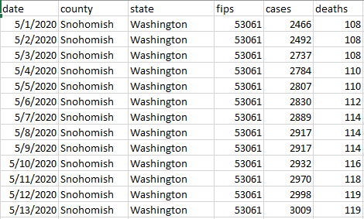
COVID Original Data
Notes:
Jon

Slide 7
Data Quality Report - Air Quality (Original Data)
Unreasonable and Context-Inconsistent Data
End-date Mismatch
Lack of CO Data
Less than 50% of counties per state with CO data
Negative Sensor Values
Not States:
(DC, Puerto Rico)
Ozone only recorded to Nov 14
NO2 and PM2.5 both recorded to Oct 31
Notes:
Adriana

Slide 8
Data Quality Report - COVID-19 (Original Data)
Data had to be switched from aggregated totals to daily numbers
Some values were negative (possible mis-reporting), these were set to zero
Some values were extremely high, we clipped these values down
Data reporting didn’t start on the same date for every county
Some dates had null values, we used the interpolate function to replace null values with nearest date value from same county
Notes:
Jon

Slide 9
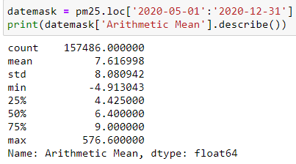
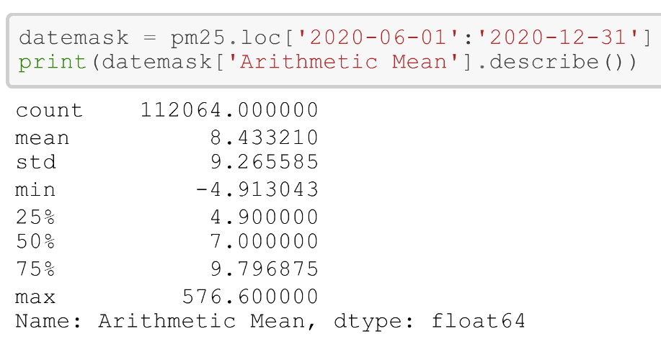
Air Quality Data - Wrangling Steps (PM2.5 as example)
Subset variables
Subset based on desired dates
Notes:
Adriana

Slide 10
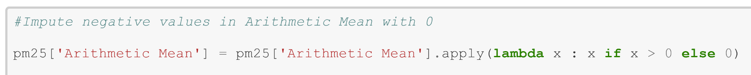
Air Quality Data - Wrangling Steps (PM2.5 as example)
Drop Not-states
Impute negative values with 0
Notes:
Adriana

Slide 11
COVID-19 Data -Wrangling Steps
Because this was the larger, more complete dataset, we adapted this dataset to merge well with the AQ data
Unique merge id of county/state/date was created
Had to ensure all county names matched between datasets
New York boroughs, Alaska boroughs, abbreviations, and capitalization of different counties/states made this more difficult
E.g. - St. Clair and Saint Clair would cause the mergeID to fail, so we had to adjust to the AQ data format
Notes:
Teigen

Slide 12
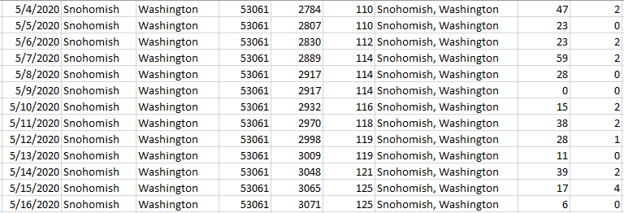
Pre-Merge COVID Data
Notes:
Teigen

Slide 13
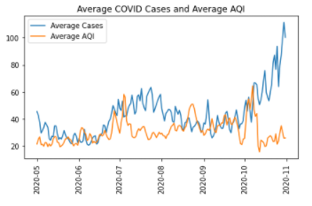
Report of the quality of merged data
The merge went well, only a little over 700 rows were left with null values
These could all be accounted for
Most often: AQ data was present, but COVID data had not started reporting yet
There were some counties that did not begin reporting COVID data until August.
The merge also highlighted the known shortcomings in the AQ data
Multiple metrics had not been reported at the time of data gathering
Notes:
Teigen

Slide 14
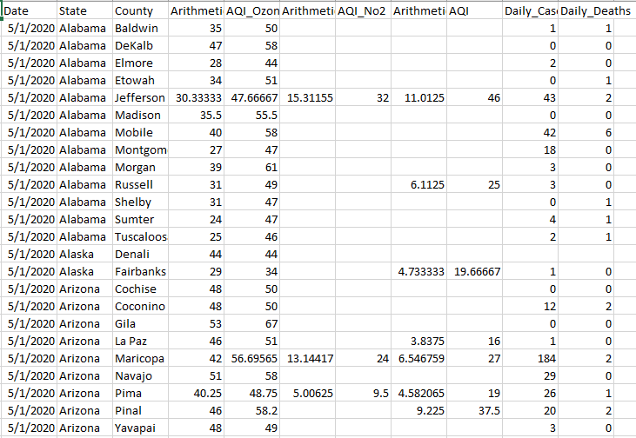
Merged Data

Slide 15
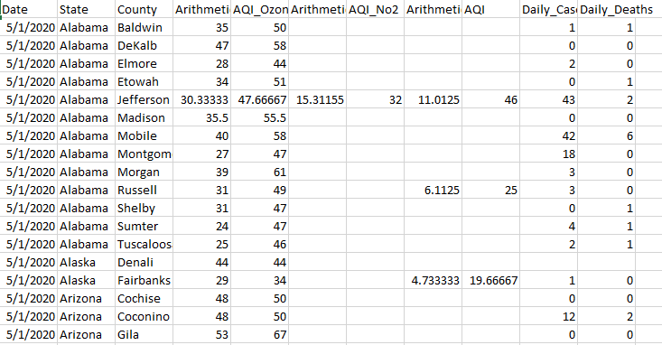
Data by AQ Metric (Ozone)
Notes:
Teigen

Slide 16
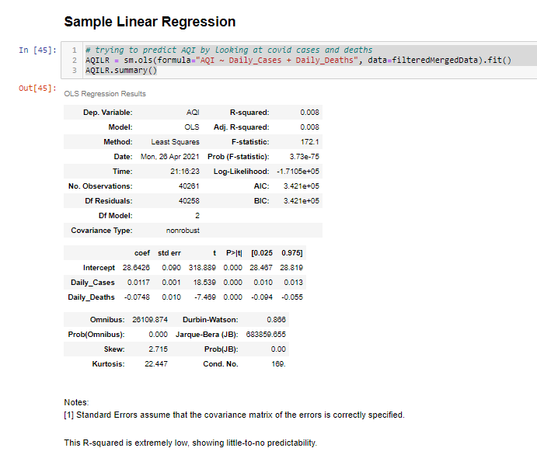
Linear Regression
Predicting AQI with COVID cases/deaths
Very low R-squared (low correlation)
Notes:
Teigen

Slide 17
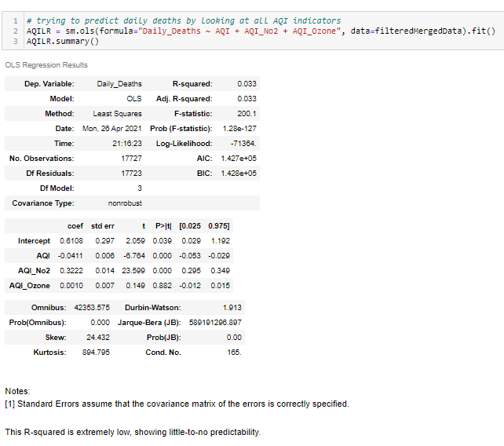
Linear Regression
Predicting COVID deaths with AQ metrics
Again, very low R-squared (low correlation)
Notes:
Teigen

Slide 18
Sources
Cazzolla Gatti, R., Velichevskaya, A., Tateo, A., Amoroso, N., & Monaco, A. (2020). Machine learning reveals that prolonged exposure to air pollution is associated with SARS-CoV-2 mortality and infectivity in Italy. Environmental pollution (Barking, Essex : 1987), 267, 115471. https://doi.org/10.1016/j.envpol.2020.115471

